Slide 1



CROSSINNO
Kick Off Meeting
Belluno – 13th January 2020
Antonella Manca | Head of Department for culture and sports
www.interreg.net

Slide 2


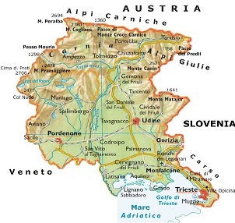

FRIULI VENEZIA GIULIA AUTONOMOUS REGION
Inhabitants: ca. 1.220.000
Area: 7.862 sq.km
Inhabitants per sq.km: 155
Expenditure in Culture/Tourism
1st Italian Region*
Culture & Creativity/Wealth & Employment
6th Italian Region*
* 2018 “Io sono Cultura” report by Symbola Foundation and Unioncamere
Kick Off Meeting – Belluno

Slide 3
CCIS IN FRIULI VENEZIA GIULIA
The cultural and creative production system in RAFVG represents 5.4% of the regional economy, with over 1.8 billion euros.
The sector involves over 34,000 workers, which represent 6.3% of the employed people in the Region.
In 2018, the Region has 3 territories among the top 20 Italian provinces by incidence of CCIs on the total number of productive enterprises.
Trieste is in 4th place with 6.1% of the ICCs on the total enterprises system, Udine in 19th place (4.8%) and Pordenone is in 20th place (4.8%).
Kick Off Meeting - Belluno

Slide 4
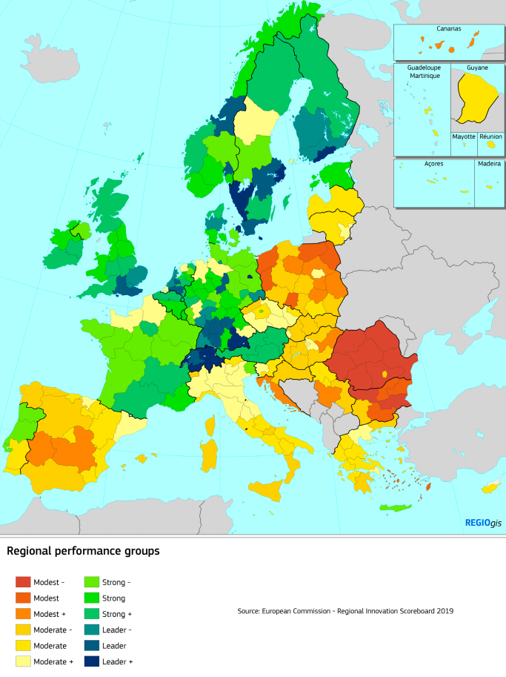
Regional Innovation Scoreboard
Innovation Performance in FVGAR:
+ 7.7%
Among the leading sectors of the regional economy, the one dedicated to design applications has an important position.
Kick Off Meeting - Belluno

Slide 5
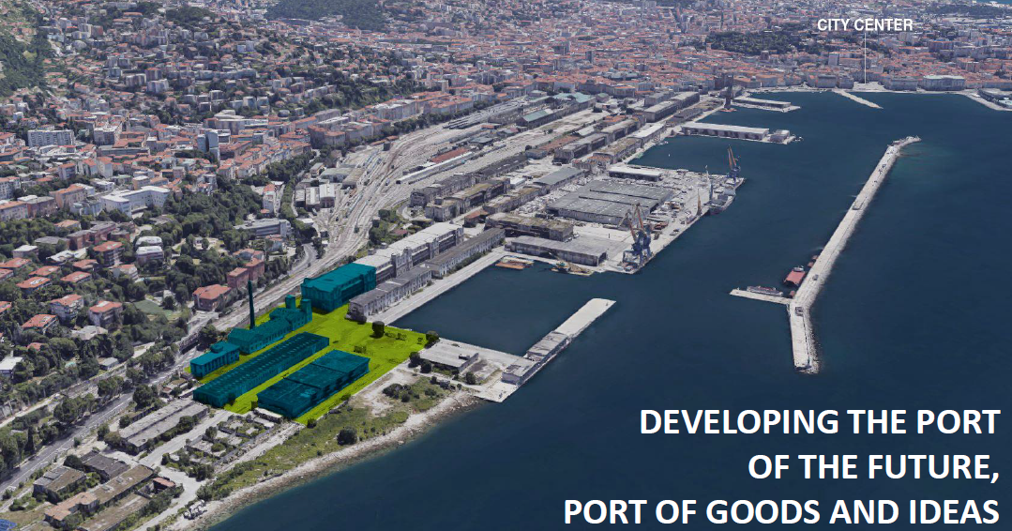
EUROSCIENCE OPEN FORUM 2020
ESOF 2020 will be held in July 2020 in Trieste
Kick Off Meeting - Belluno

Slide 6
WHAT WE DO
1
Protection and valorization regional cultural heritage;
2
Promotion of cultural activities;
Support to the starting-up and the development of Cultural and Creative Industries (ICCs);
Valorisation of the regional cultural heritage in terms of tourism.
3
4
Kick Off Meeting - Belluno

Slide 7
REGIONAL POLICIES FOR CCIs IN FRIULI VENEZIA GIULIA
Regional cultural heritage
Cultural and creative Industries
ERPAC
EU Projects
  COME-IN!
  SMATH
  CROSSINNO
  CREATURES
POR FESR 2014 – 2020
EU Projects
  CRE:HUB
  ChIMERA
  SMATH
  SACHE
Kick Off Meeting - Belluno

Slide 8

$
$
ROP-ERDF 2014 - 2020
Activity 2.1.b – Actions focused on start-up processes in the field of culture, creativity and tourism.
1
1° call: Acceleration and consolidation
Total budget: 700.000,00 €
2
2° call: Pre-Incubation and incubation
Total budget: 1.300.000,00 €
3
3° call: Pre-Incubation and incubation
Total budget: 2.026.450,80 €
Kick Off Meeting - Belluno

Slide 9

CLUSTER FOR CULTURE AND CREATIVITY
The budget of the cluster is about 450.000€ in the period 2019 - 2021
Kick Off Meeting - Belluno

Slide 10
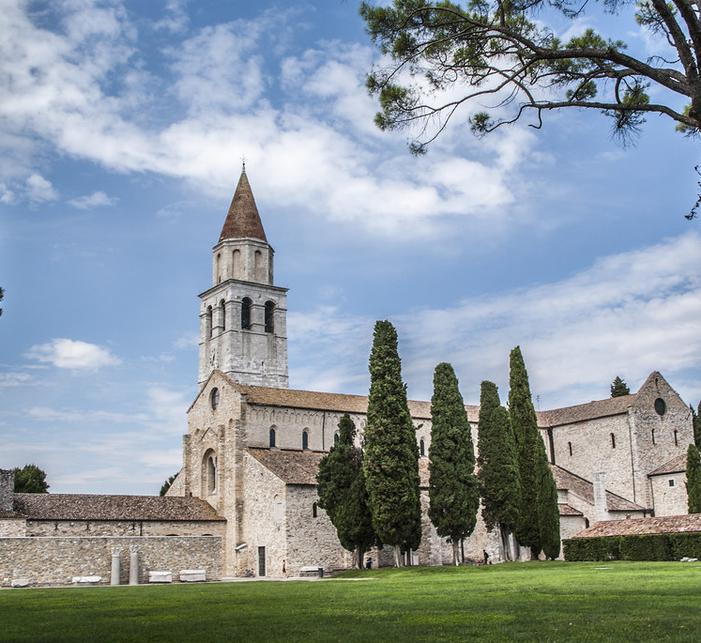

CULTURAL ASSETS IN FRIULI VENEZIA GIULIA
Aquileia archeological site
PAFF!
Kick Off Meeting - Belluno

Slide 11
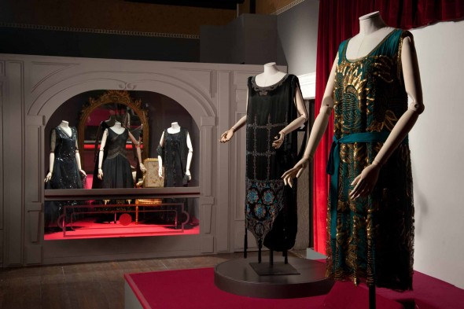
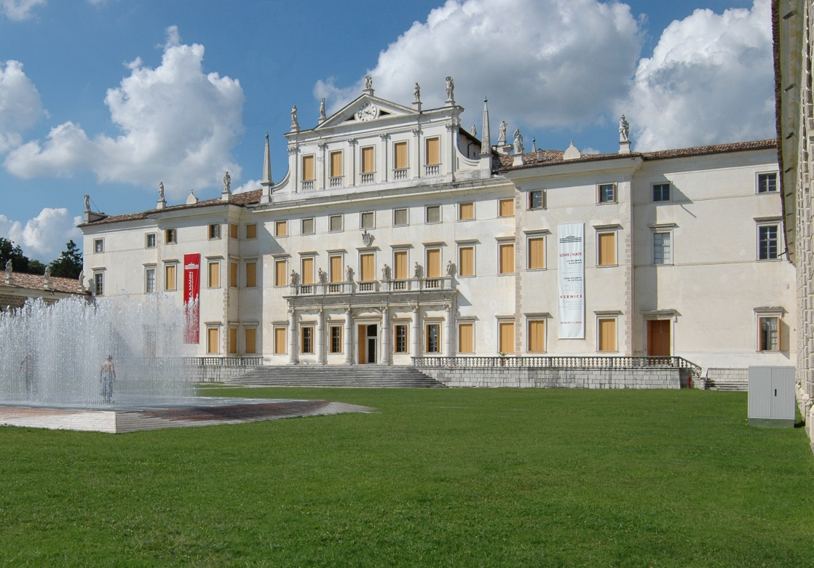

CULTURAL ASSETS IN FRIULI VENEZIA GIULIA
Gorizia Museums
Villa Manin
Kick Off Meeting - Belluno

Slide 12
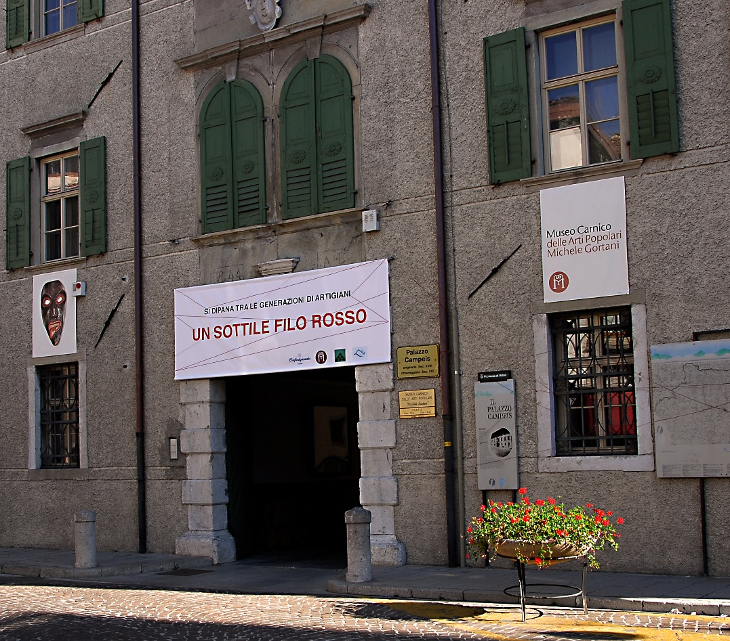
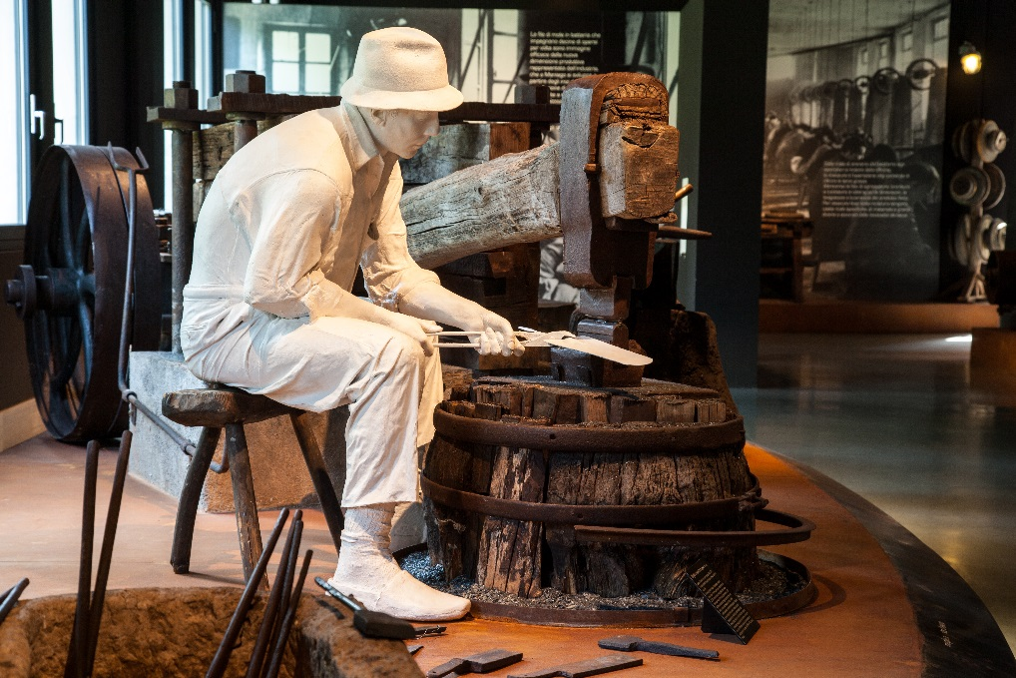
CULTURAL ASSETS IN FRIULI VENEZIA GIULIA
Museo Carnico delle Arti Popolari Michele Gortani
Museo dell’Arte Fabbrile e delle Coltellerie
Kick Off Meeting - Belluno

Slide 13

Thank you!
Your subtitle text here
Antonella Manca
Friuli Venezia Giulia Autonomous Region
Head of Department for culture and sports
+39 0403773429
antonella.manca@regione.fvg.it
www.interreg.net

